Slide 1
Gen-Z Career Aspirations: Insights & Findings
Prepared by Silpa

Slide 2
Project overview
Goals of the project
Scope of the project
Significance of the project
Prob
Data Collection
Description of how the data was gathered, including surveys with trailored questions.
Problem Statement
Challenges related to understanding Gen-Z career aspirations and employer expectations.
Excel Dashboard
A high-level summary of the dashboards created for Gen-Z aspirations.
Analysis with Exel
Key insights derived using Pivot tables
Data Cleaning
Steps taken in SQL/Excel to clean and prepare the data for analysis.
Focused Power BI Dashboards
Detailed analysis on Manager Aspirations and Mission Aspirations dashboards
Findings & Recommendations
Actionable insights for recruiters, HR leaders, and employers.

Slide 3
PROBLEM STATEMENT

Slide 4
What are the challenges and problems facing Gen Z’s?
"why" behind Gen Z's challenges from confluence of societal, economic, and
technological factors?
Job Insecurity and Economic Uncertainty Because they started their career in pandemic type.The rapid pace
of technological change requires constant learning and adaptation.Rising of gig economy leads to job
insecurity,lower wages.. Etc.,
There are many things we have to think about like Economic Recession and Pandemic, Rising Cost of Higher
Education, Rapid Technological Advancements, Mental Health Concerns, Focus on Meaningful Work.
Day to day they have to update their skills.

Slide 5
When the GenZ’s are currently entering?
Where are they seeking the opportunities?
The oldest members of Gen Z are currently entering the workforce.Delloite states that Gen Z is expected to
represent 27% of the workforce by 2025.
This means that while some Gen Zers are already established in their careers, the majority are still in the early
stages of their professional journeys.
Online job boards, Social media, Company websites, Employee references, Campus career fairs.

Slide 6
Who is deciding their career opportunities?
How are they different from other generations?
Flexibility, remote work options, and opportunities for personal space. Positive work environment,
Supportive managers, Long-term aspirations, desired job titles, long-term financial stability.
Gen Z is less likely to adhere to traditional workplace hierarchies and power structures.
They are highly tech-savvy and comfortable with technology.
They are quick learners and adaptable to new technologies.
They are more likely to embrace remote work, freelance opportunities.

Slide 7

DATA COLLECTION

Slide 8
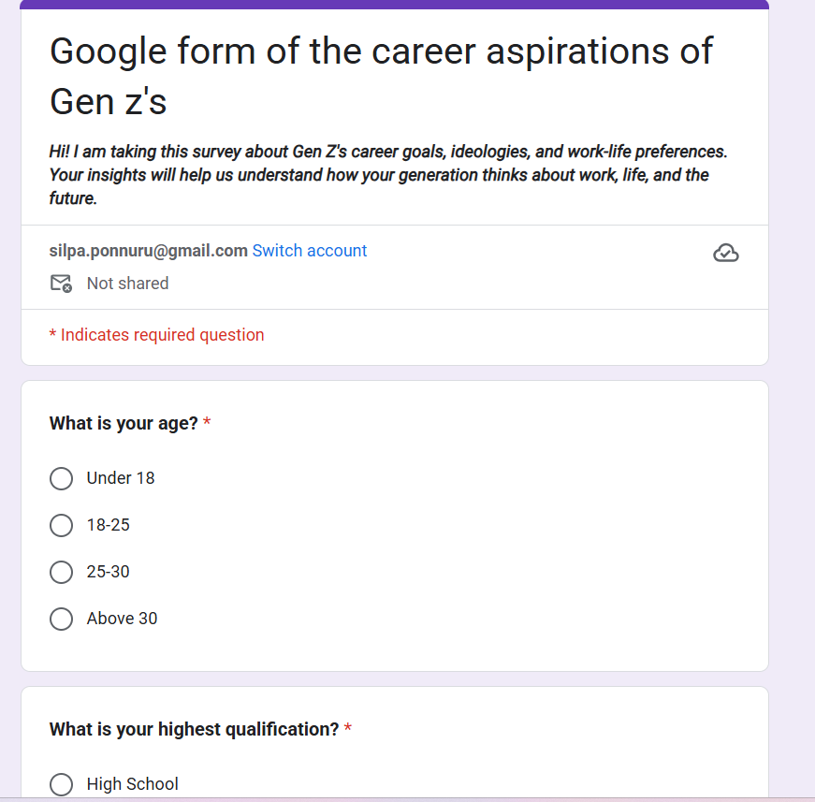
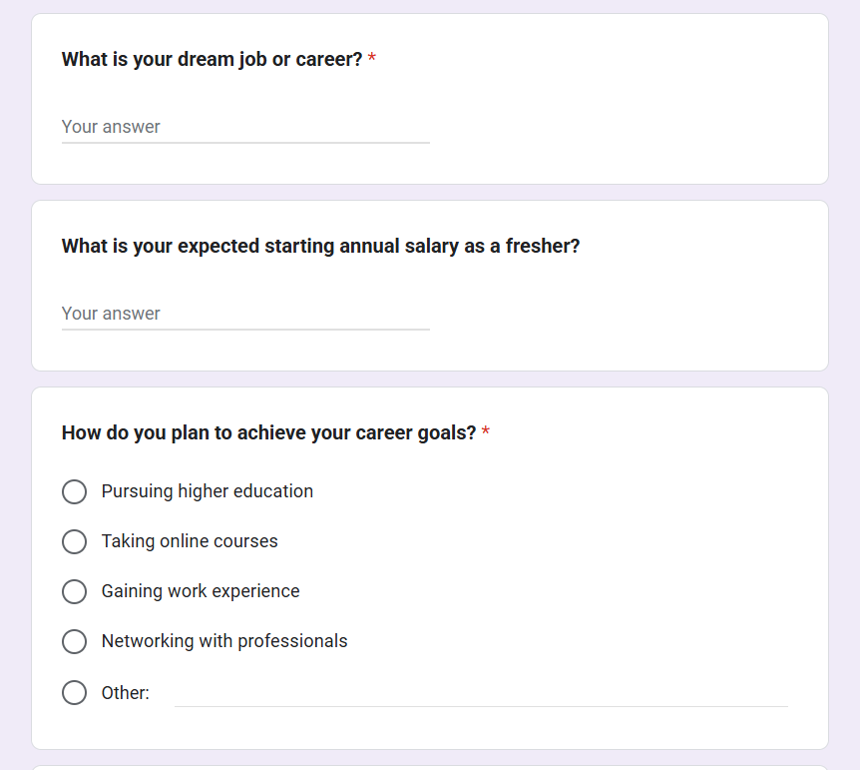

Slide 9
DATA CLEANING AND STANDARDIZING

Slide 10
1. What industries are Gen‑Z most interested in pursuing careers in?
2. What are the top factors influencing Gen‑Z’s career choices?
3. What is the desired work environment for Gen-Z?
(e.g., remote,hybrid, in-office)
4. How do financial goals, such as salary and benefits,impact career aspirations among Gen-Z?
5. What role do personal values and social impact play in career choices for Gen-Z?

Slide 11
SELECT
Aspirational_Job,
COUNT (*) AS Total_Responses
FROM GenZ_Careers
GROUP BY Aspirational_Job
ORDER BY Total_Responses DESC;
SELECT
Influencing_Factors,
COUNT(*) AS Factor_Interest_Count
FROM GenZ_Careers
GROUP BY Influencing_Factors
ORDER BY Factor_Interest_Count DESC;
SELECT
Preferred_Working_Environment AS Work_Environment,
COUNT(*) AS Preference_Count
FROM GenZ_Careers
GROUP BY Preferred_Working_Environment
ORDER BY Preference_Count DESC;

Slide 12
SELECT
ROUND(AVG(Minimum_Monthly_Salary_Start), 2) AS Avg_Starting_Salary,
ROUND(AVG(Minimum_Monthly_Salary_3Years), 2) AS Avg_Salary_After_3_Years,
ROUND(AVG(Minimum_Monthly_Salary_5Years), 2) AS Avg_Salary_After_5_Years
FROM GenZ_Careers;
SELECT
Company_With_No_Social_Impact AS Social_Impact_Preference,
COUNT(*) AS Response_Count
FROM GenZ_Careers
GROUP BY Company_With_No_Social_Impact
ORDER BY Response_Count DESC;

Slide 13
ANALYZING DATA WITH PIVOT TABLE

Slide 14
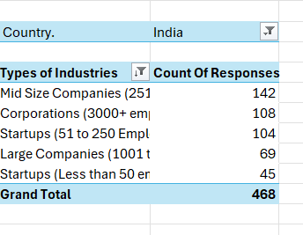
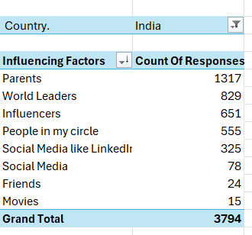
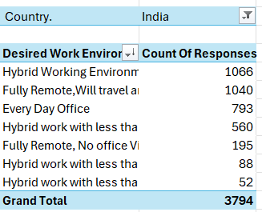
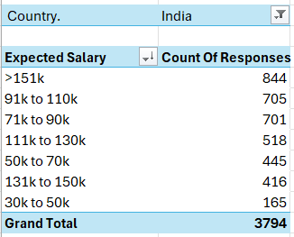

Slide 15
Excel Dashboard

Slide 16
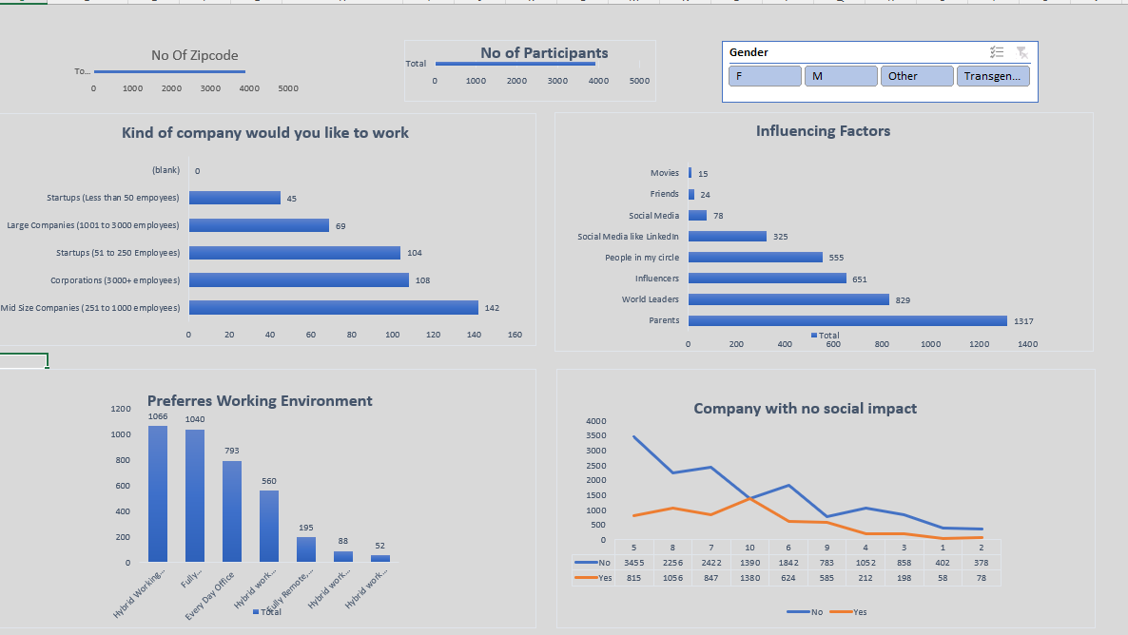

Empowerment Gen Z : Career Aspirations Dashboard

Slide 17
FOCUSED POWERBI DASHBOARDS

Slide 18
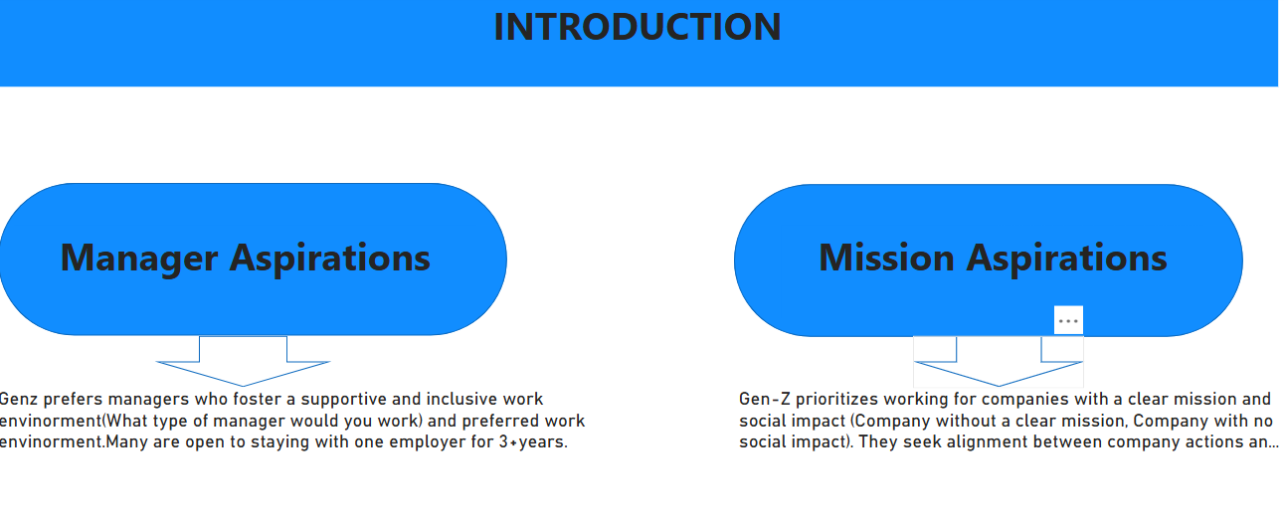

Slide 19
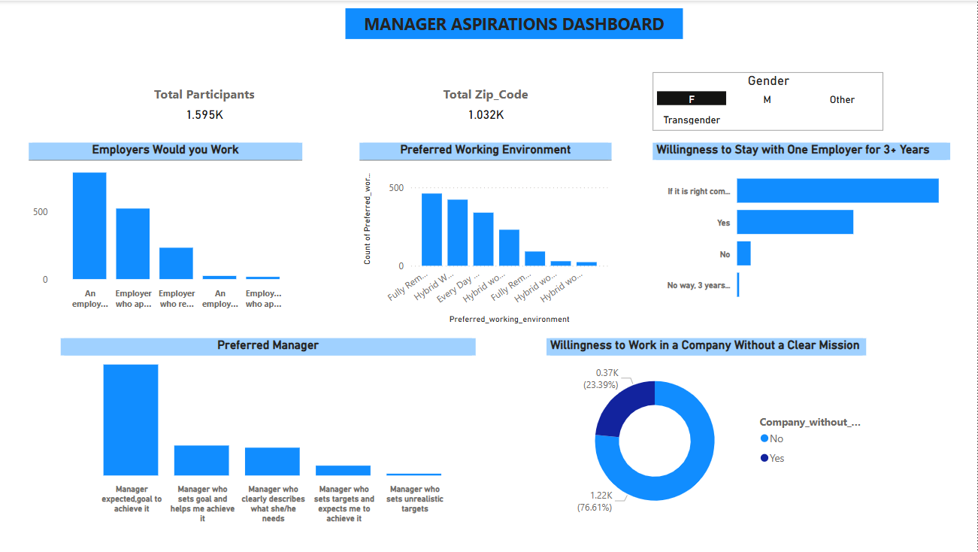

Slide 20
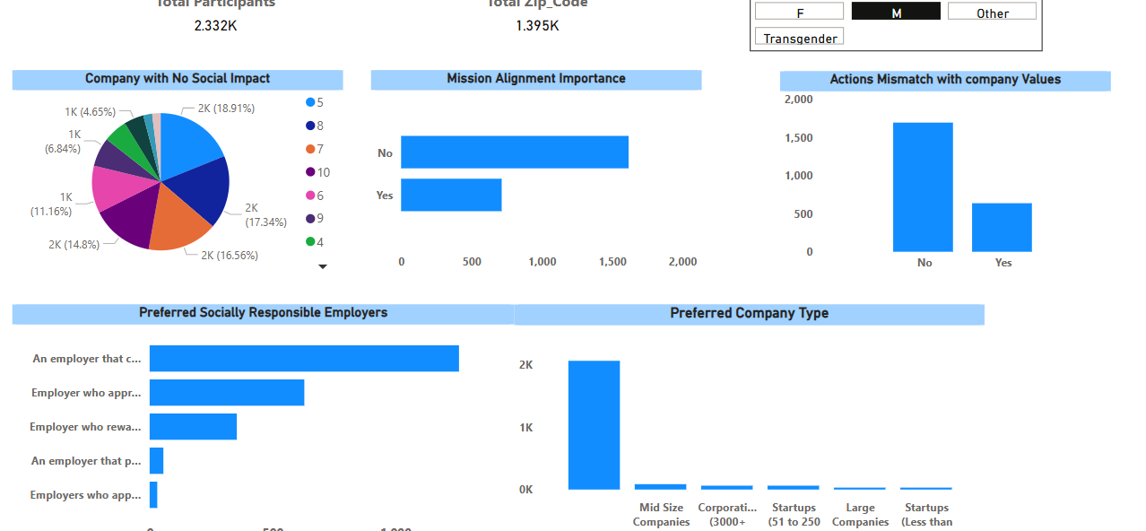

Slide 21
FINDINGS &RECOMMDATIONS

Slide 22
🔹 Key Findings
Gen-Z Prefers Purpose-Driven Careers
Work-Life Balance & Flexibility Are Top Priorities
Expectation of Fast Career Growth & Learning Opportunities
Salary Expectations Are Increasing Rapidly
Feedback-Driven & Tech-Savvy Workforce

Slide 23
Final Takeaways for Employers
1.Purpose + Pay + Growth = Gen-Z Retention 2.Flexible work culture is a must, not a perk 3.Invest in mentorship & learning for long-term engagement 4.Salary transparency builds trust with Gen-Z applicants

